Slide 1
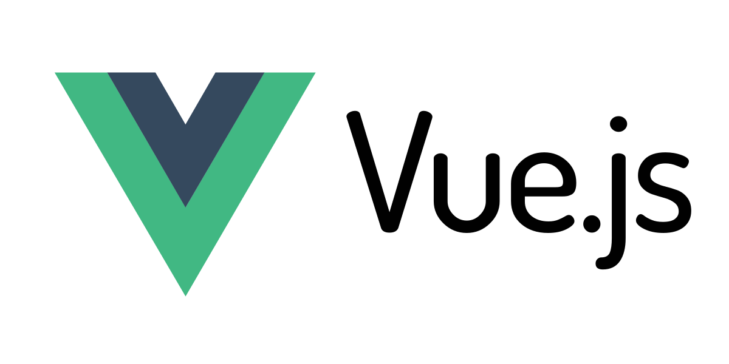

Slide 2
Agenda
1. What Vue.js is?
2. Pros and Cons
3. Creating a Vue.js application
4. Running and publishing a Vue.js application
5. Structure of a Vue.js application
6. HTTP requests
7. Templates
8. Pages and Components
8.1 Conditional rendering
8.2 List rendering
8.3 Conditional styling
8.4 Event handling
8.5 Custom events
8.6 Lifecycle hooks
8.7 Watchers
8.8 Props
8.9 Refs
8.10 Slots
8.11 Directives
8.12 Custom directives
9. Plugins
9.1 State management
9.2 Routes
9.3 Routes with parameters
10. PWA support

Slide 3
What is Vue.js
Progressive JavaScript Framework
https://vuejs.org/
Version 3
By Evan You

Slide 4
Vue.js vs Angular 2+ vs. React
 | Vue.js | Angular 2+ | React
Version | 3 | 13.x | 17.x
Developed by | Dev Community | Google | Facebook/Meta
Initial release | 2014 | 2010 | 2013
Stars on GitHub | 29.4k | 80.9k | 187k
Programming language | JS/TS | TS | JS
Syntax | Virtual DOM | Real DOM | Virtual DOM
Architecture | Flux | MVC | Flux
Learning curve | Moderate | Steep | Moderate
Performance | Fast | Slow | Normal

Slide 5
Creating a new Vue.js application
> npm init vue@latest
> cd <your-project-name>
> npm install

Slide 6
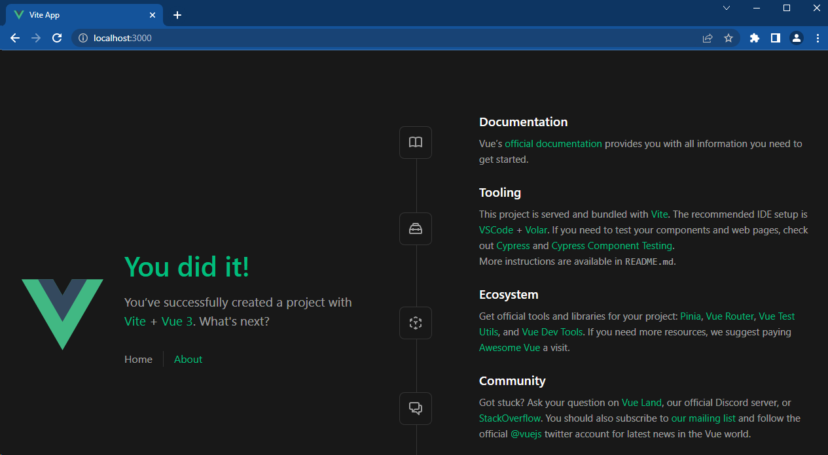
Running a Vue.js application
> npm run dev

Slide 7
Building a Vue.js application
> npm run build

Slide 8
Structure of a Vue.js application

Slide 9
HTTP requests
Vue.js is only a UI framework and doesn’t come with any functionality that does not involve the UI (like making HTTP requests).
For additional functionality external libraries (like Axios for HTTP requests).

